Slide 1
Jpos and Spring framework integration for financial transaction
Java User Group Indonesia – October 2014
Galih Lasahido

Slide 2
Galih lasahido
@ : galih.lasahido@gmail.com
Working Experience
Bank DKI
Asuransi Jasindo
Freelance Programer
Gunadarma University Computing Center

Slide 3
Agenda
ISO 8583 Introduction
jPos and jPos EE
Spring Framework for web base interface
jPos Server Simulator
jPos Client Simulator
Q & A

Slide 4
Stack technology
JPos
JPos EE
Spring Framework
Gradle
Postgre SQL 9.2
Intellij Idea
Bootstrap Twitter
Freemarker
Jetty
Hibernate
Spring Data

Slide 5

How does it work

Slide 6
ISO 8583
http://en.wikipedia.org/wiki/ISO_8583
ISO 8583 defines a message format and a communication flow so that different systems can exchange these transaction requests and responses.
3 Part Of ISO 8583
MTI (Message Type Identifier)
Bitmaps
Data Elements

Slide 7
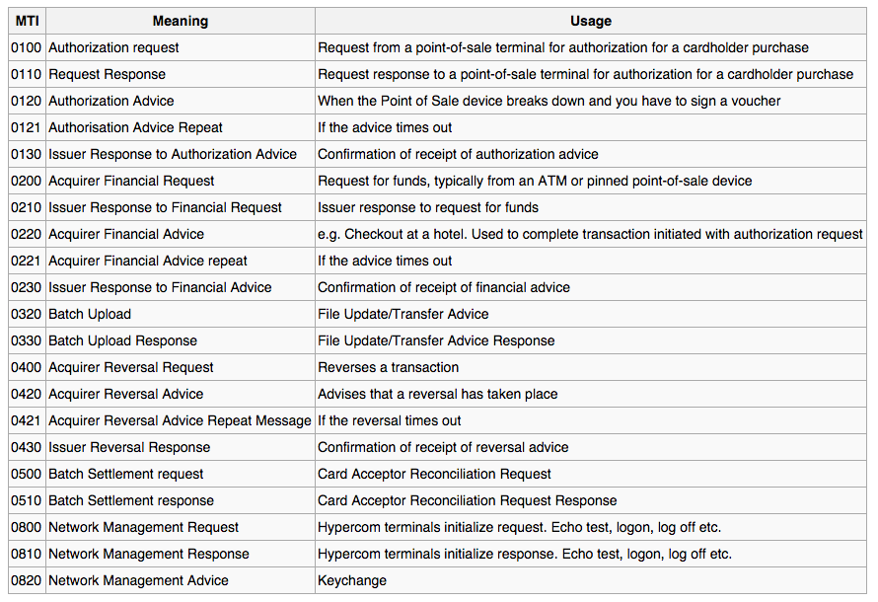
ISO 8583: MTI

Slide 8
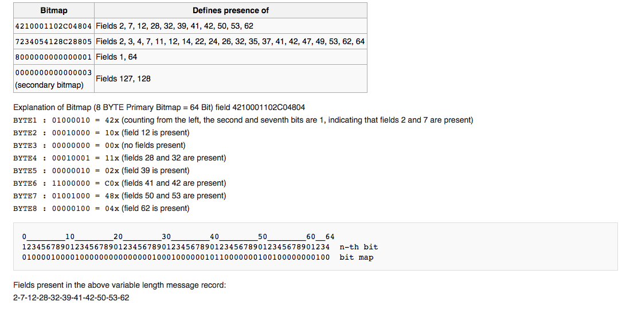
ISO 8583 : Bitmap

Slide 9
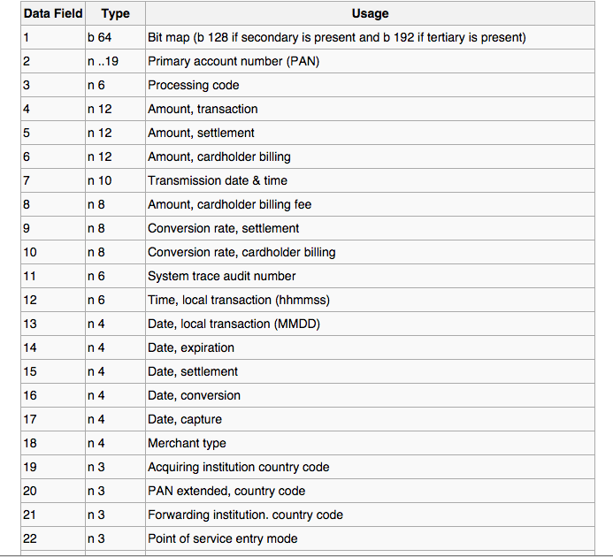
ISO 8583 : Data element
See http://en.wikipedia.org/wiki/ISO_8583 or any other resources for more detail :P

Slide 10
For the main course, we’ll have a jpos please
What is jPOS?
jPOS is an open-source, mission-critical enterprise software, based on International Organization for Standardization transaction card originated messages standard (ISO-8583).
http://jpos.org/
Guide http://jpos.org/doc/proguide-draft.pdf
jPos is not JavaPOS
https://github.com/jpos
https://groups.google.com/forum/#!forum/jpos-users
http://andyorrock.typepad.com/
http://jpos.org/maven/org/jpos/ee/

Slide 11


Cooking server simulator for a client
server
client
iso message
database

Slide 12
Quick course on what to use
ISOChannel : ISOChannel is used to send and receive ISOMsg objects.
Packager : Packager is used to define data element mapping
ISORequestListener : Once a new connection is accepted and an ISOChannel is created, a ThreadPool-controlled Thread takes care of receiving messages from it. Those messages are passed to an ISORequestListener implementation
TransactionManager : handling simultaneous transactions, receive request from ISORequestListener.
Participants : handel routing transaction for group in TransactionManager.
ISOMsg : handle the content of iso message

Slide 13
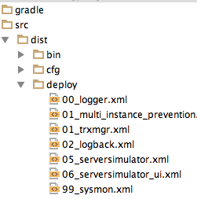
A quicky way for server simulator
Using git clone the jPos-template
$ git clone https://github.com/jpos/jPOS-template.git
$ mv jPOS-template server
$ cd server
$ gradle idea
edit file build.gradle
$ gradle installResources
$ gradle clean run
$ gradle dist (distribution for production)

Slide 14
Gradle dependency IN BUILD.GRADLE
compile ('org.jpos.ee:jposee-db-postgresql:2.0.6-SNAPSHOT') {
exclude(module: 'postgresql')
}
compile 'org.jpos.ee:jposee-dbsupport:2.0.6-SNAPSHOT'
compile 'org.jpos.ee:jposee-syslog:2.0.6-SNAPSHOT'
compile 'org.jpos.ee:jposee-logback:2.0.6-SNAPSHOT'
compile 'org.jpos.ee:jposee-server-simulator:2.0.6-SNAPSHOT'
// see http://jpos.org/maven/org/jpos/ee/
compile 'org.springframework:spring-context:4.0.3.RELEASE'
compile 'org.springframework:spring-context-support:4.0.3.RELEASE'
compile 'org.springframework:spring-webmvc:4.0.3.RELEASE'
compile 'org.springframework:spring-orm:4.0.3.RELEASE'
// see http://spring.io/
compile 'org.postgresql:postgresql:9.3-1102-jdbc41'
compile 'cglib:cglib:2.2.2'
compile 'org.freemarker:freemarker:2.3.20'
compile 'org.liquibase:liquibase-core:3.2.2'

Slide 15
Iso message
Receive by Qserver, ASCIIChannel, ISO87APackager
In request-listener, save the msg to space
In TransactionManager route with selector
From selector return a group name in a TransactionManager
Run Process Class

Slide 16
Server xml
<server class="org.jpos.q2.iso.QServer" logger="Q2" name="simulator_10000">
<attr name="port" type="java.lang.Integer">10000</attr>
<channel class="org.jpos.iso.channel.ASCIIChannel" logger="Q2" packager="org.jpos.iso.packager.ISO87APackager"/>
<request-listener class="com.smartbee.jamu.jpos.server.jpos.ISORequest" logger="Q2"/>
</server>

Slide 17
Transaction manager xml
<?xml version="1.0" encoding="UTF-8"?>
<txnmgr name="MyTxn" logger="Q2" class="org.jpos.transaction.TransactionManager">
<property name="space" value="tspace:default" />
<property name="queue" value="MyTxnQueuePG" />
<property name="session" value="100" />
<property name="debug" value="true" />
<participant class="com.smartbee.jamu.jpos.server.jpos.Selector" logger="Q2">
<property name="0200001" value="Inquiry" />
</participant>
<group name="Inquiry">
<participant class="com.smartbee.jamu.jpos.server.jpos.Inquiry" logger="Q2"/>
</group>
</txnmgr>

Slide 18
Classes
File SDatabase.java
File Database.java
File Selector.java
File MessageWebApplicationInitializer.java
File ISORequest.java
File Inquiry.java
File DBCore.java
File in repository package

Slide 19
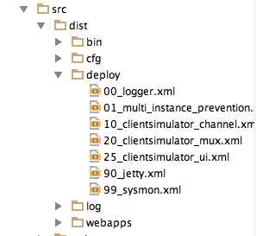
A quicky too : client simulator
Using git clone the jPos-template
git clone https://github.com/jpos/jPOS-template.git
mv jPOS-template client
cd client
gradle idea
gradle installResources
gradle clean run
gradle dist (distribution for production)

Slide 20
dependencies {
compile ('org.jpos:jpos:1.9.8') {
exclude(module: 'junit')
exclude(module: 'hamcrest-core')
}
compile ('org.jpos.ee:jposee-db-postgresql:2.0.6-SNAPSHOT') {
exclude(module: 'postgresql')
}
compile 'org.jpos.ee:jposee-jetty:2.0.6-SNAPSHOT'
compile 'org.jpos.ee:jposee-client-simulator:2.0.6-SNAPSHOT'
compile 'org.springframework:spring-context:4.0.3.RELEASE'
compile 'org.springframework:spring-context-support:4.0.3.RELEASE'
compile 'org.springframework:spring-webmvc:4.0.3.RELEASE'
compile 'cglib:cglib:2.2.2'
compile 'org.freemarker:freemarker:2.3.20'
compile 'javax:javaee-api:7.0'
compile'org.eclipse.jetty:jetty-server:9.2.2.v20140723'
compile 'org.eclipse.jetty:jetty-jsp:9.2.2.v20140723'
testCompile 'junit:junit:4.8.2'
}

Slide 21
10_clientsimulator_channel.xml
<channel-adaptor name='clientsimulator-adaptor' class="org.jpos.q2.iso.ChannelAdaptor" logger="Q2">
<channel class="org.jpos.iso.channel.ASCIIChannel" logger="Q2" packager="org.jpos.iso.packager.ISO87APackager">
<property name="host" value="127.0.0.1" />
<property name="port" value="10000" />
</channel>
<in>clientsimulator-send</in>
<out>clientsimulator-receive</out>
<reconnect-delay>10000</reconnect-delay>
</channel-adaptor>

Slide 22
20_clientsimulator_mux.xml
<mux class="org.jpos.q2.iso.QMUX" logger="Q2" name="clientsimulator-mux">
<in>clientsimulator-receive</in>
<out>clientsimulator-send</out>
<unhandled>clientsimulator-unhandled</unhandled>
</mux>

Slide 23
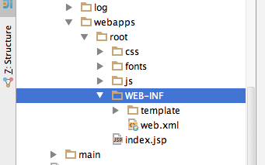
Jetty for gui

Slide 24
<display-name>Archetype Created Web Application</display-name>
<servlet>
<servlet-name>spring</servlet-name>
<servlet-class>org.springframework.web.servlet.DispatcherServlet</servlet-class>
<init-param>
<param-name>contextClass</param-name>
<param-value>
org.springframework.web.context.support.AnnotationConfigWebApplicationContext
</param-value>
</init-param>
<init-param>
<param-name>contextConfigLocation</param-name>
<param-value>
com.smartbee.jamu.jpos.client.config.WebConfig
</param-value>
</init-param>
</servlet>
<servlet-mapping>
<servlet-name>spring</servlet-name>
<url-pattern>/</url-pattern>
</servlet-mapping>

Slide 25
Classes
File WebConfig.java
File AtmSimulation.java

Slide 26
Q & A

Slide 27
Terima-kasih

